Slide 1



Medical Journals Curation

Slide 2







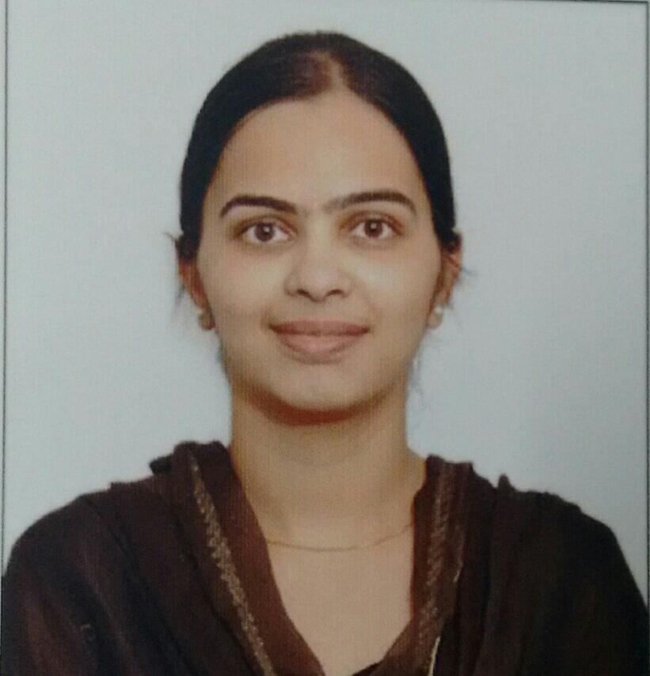
MANOHAR
D.B.Chary
Veerender
Srivathsa
https://www.linkedin.com/in/sai-srivathsa-28288a165/
https://www.linkedin.com/in/veerender-reddy-99687a212/
https://www.linkedin.com/in/manohar-kumar-969106192/
https://www.linkedin.com/in/brahma-chary-dursheti-a4012655/
Naveen
Maurya
Vauhini
Harish
RaviTeja
https://www.linkedin.com/in/vauhini-v-b20b8a143/
https://www.linkedin.com/in/vunnamharishchowdary/
https://www.linkedin.com/in/naveen-b-938986113/
https://www.linkedin.com/in/sai-srivathsa-28288a165/

Slide 3

CONTENT
Scope, Goals and Objectives
G
01
Reading and Exploring the Data
I
02
Data Pre-Processing
S
Pre-Trained Models
E
03
Deployment
D
04
05

Slide 4
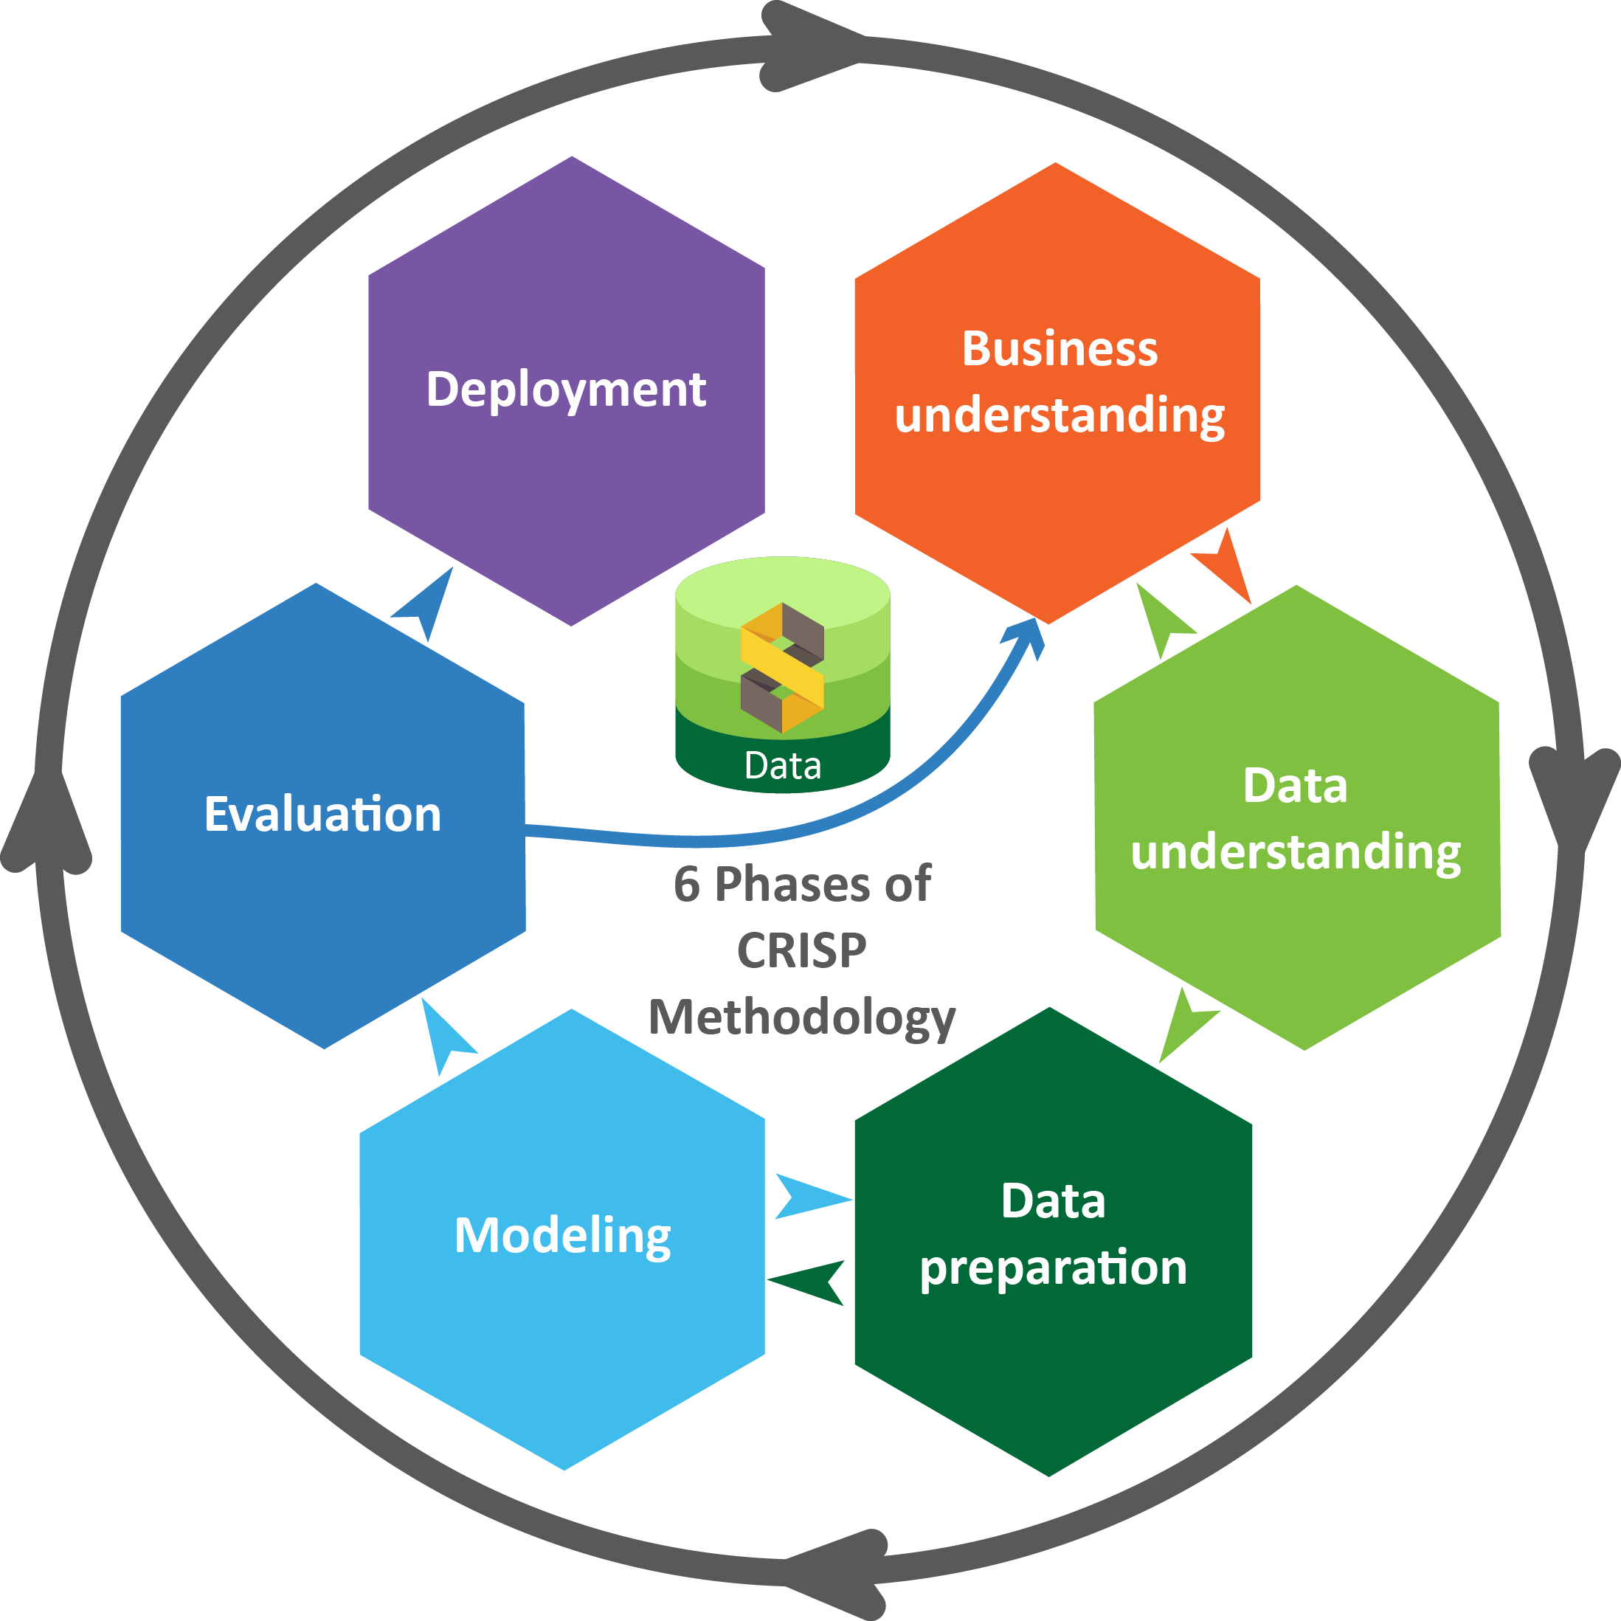
Business pipeline: CRISP-DM Methodology

Slide 5
Project Scope
The increasing number of biomedical articles and resources, searching for and extracting valuable information has become challenging.
Researchers consider multiple information sources and transform unstructured text data into refined knowledge to facilitate research productivity.
However, manual annotation and feature generation by biomedical experts are inefficient because they involve a complex process and require expensive and time-consuming labour. Therefore, efficient and accurate natural language processing (NLP) techniques are becoming increasingly important for use in computational data analysis, and advanced text mining techniques are necessary to automatically analyse the biomedical literature and extract useful information from texts

Slide 6


Project Goals
Our major goal is to apply biomedical text mining, named entity recognition (NER) which is an important task used to extract information and to recognize the Medical entities from biomedical articles.
Objectives
Constraints
To maximise the utilisation of free-text medical journals and electronic health records (EHR), we focused on a particular subtask of clinical information extraction and developed a dedicated named-entity recognition web application. Where our model involves in identifying concepts of interest in free texts is a sub-task of information extraction, more commonly known as Named-Entity Recognition (NER) and seeks to classify tokens (words) into pre-defined categories.
The words (tokens) that were identified as concepts and classified (labelled) appropriately:
A. Proteins
B. Chemicals
C. Diseases
Biomedical NER is a particularly complex task because biological entities
continually increase with new discoveries,
have large numbers of synonyms,
are often referred to using abbreviations,
are described by long phrases, and
are mixtures of letters, symbols, and punctuation
Hence, in our doing several approaches have been proposed to minimize these issues.

Slide 7










Technical Stacks

Slide 8
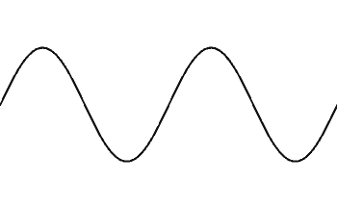
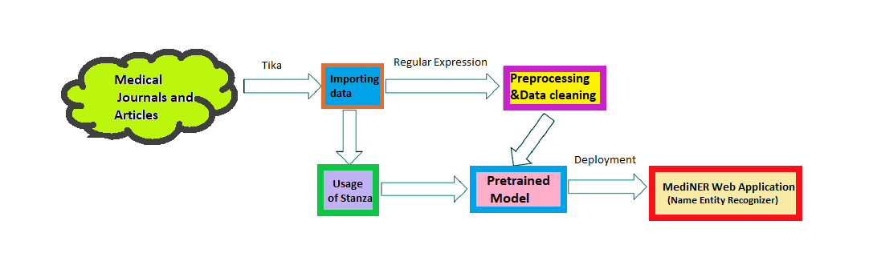
Project Architecture

Slide 9
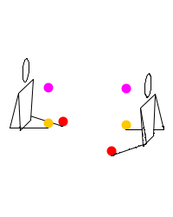
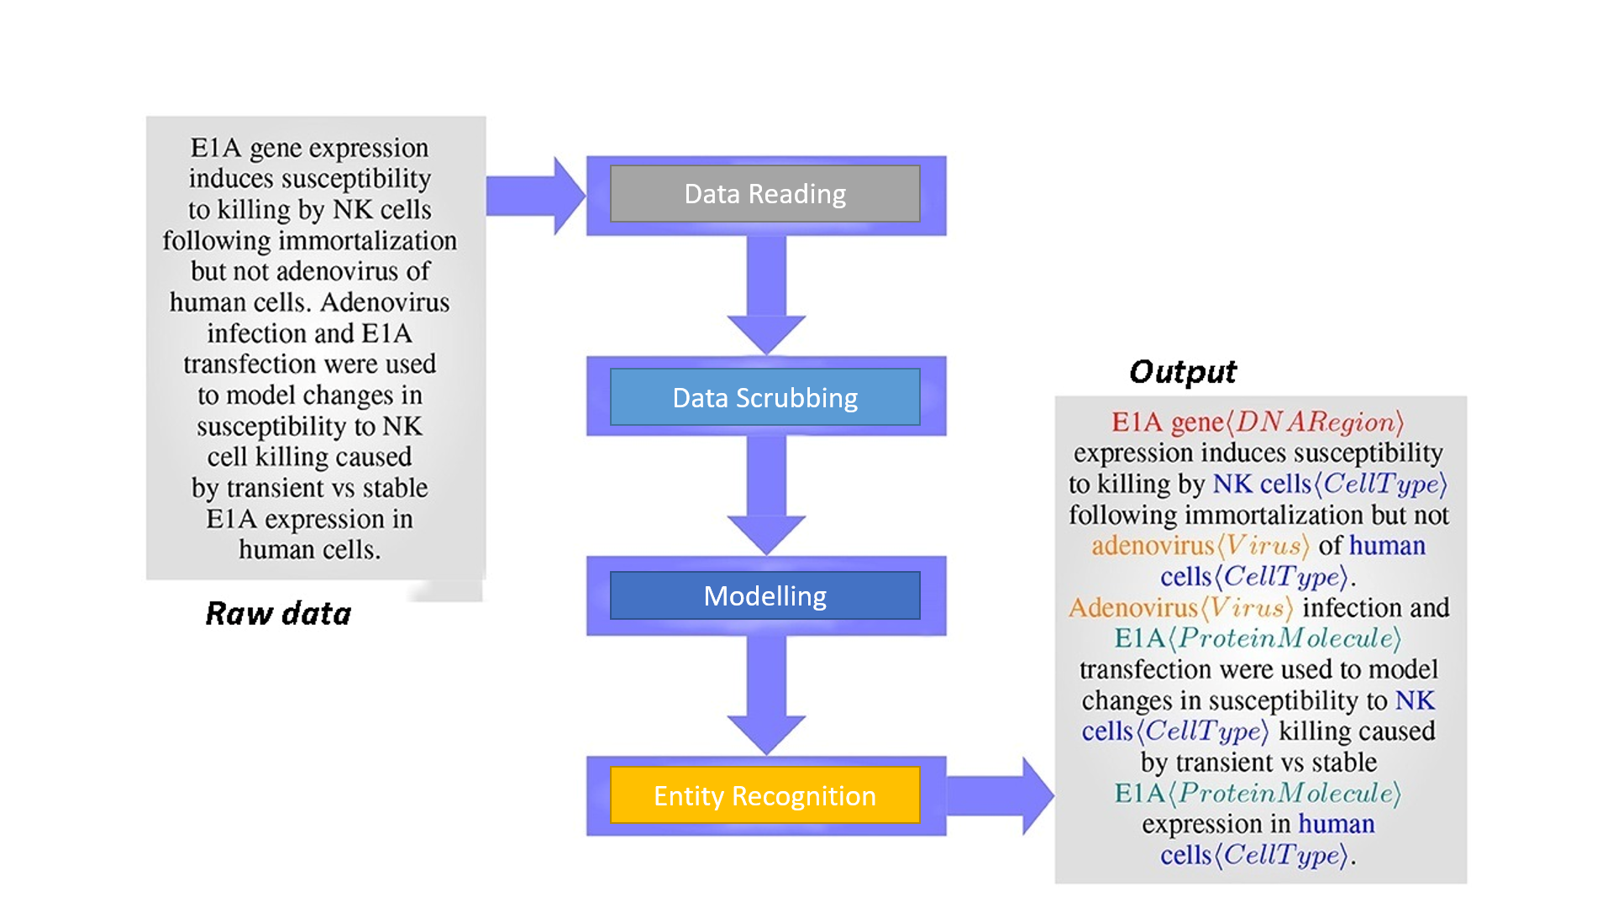
More detailed Architecture

Slide 10

Data Preparation
The data was shared by the client and they were in Portable Document Format(pdf) as they were all Medical Journals. These PDFs were used for information extraction that seeks to locate and classify entities in unstructured text.
Medical journals are published regularly to communicate new research to clinicians, medical scientists, and other healthcare workers.
Our motive was to focus on articles and journals that focus on the practice of medicine or any medical specialty.
The utilization of Apache Tika™ toolkit helps in detecting and extracting text from different file types (such as PPT, XLS, and PDF).
All of these file types can be parsed through a single interface, making Tika useful for search engine indexing, content analysis, translation, and much more.
Requirements of Tika: JDK(java 7+), Operating System Version: Windows XP or above, Linux, Memory:1 GB RAM (recommended).

Slide 11
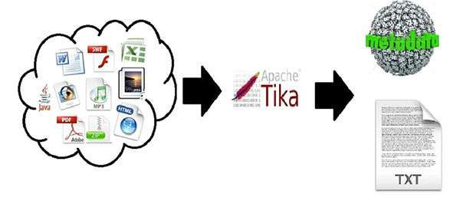
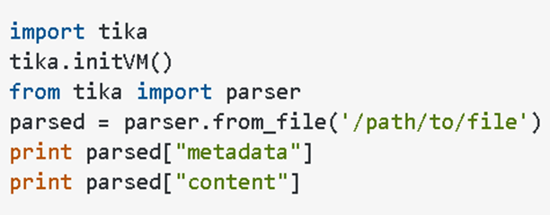
Data Preparation
“The Tika-python”
The future out scope on using Tika is that this simple parsing tool can be deployed in Azure (Python- Flask Webb APP) such that we can upload a complete pdf file into our web application. For now a simple web app is working on local machine to which we give our raw data to extract the proper entities.

Slide 12
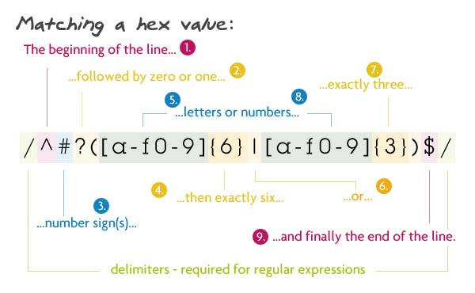
Data Preparation
The REGEX(regular Expression) is a sequence of characters that helps you match or find other strings or set of strings, using a specialized syntax held in a pattern
The “re” Module of python was used to get rid of unnecessary attributes which caused irrelevant capturing of entities while exploring the data. Usage of “re” helped our model to capture accurate entity labels.

Slide 13
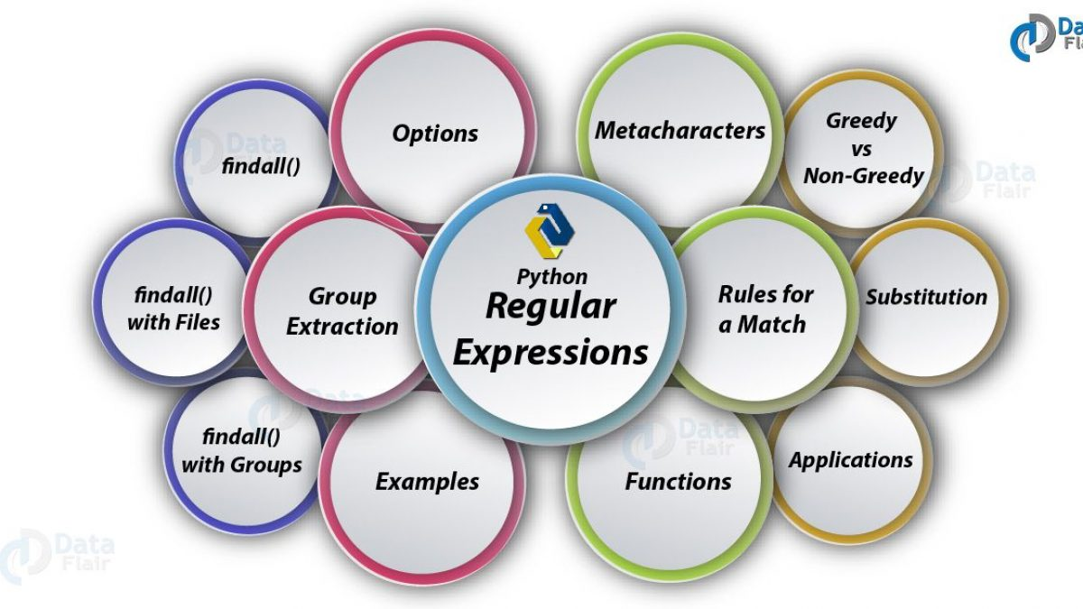
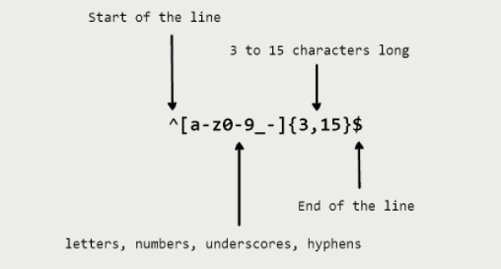
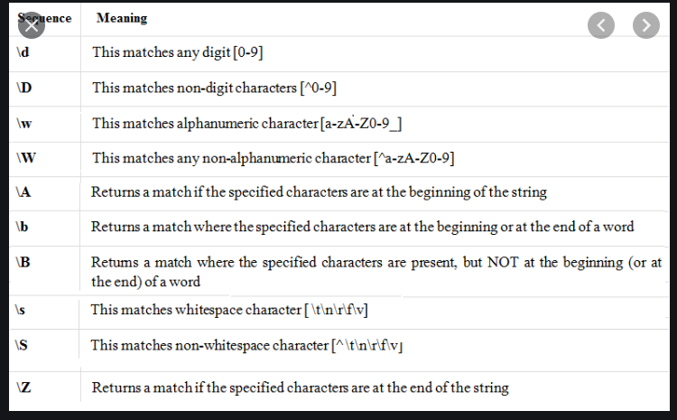
Data Preparation
Features of Regular Expression

Slide 14
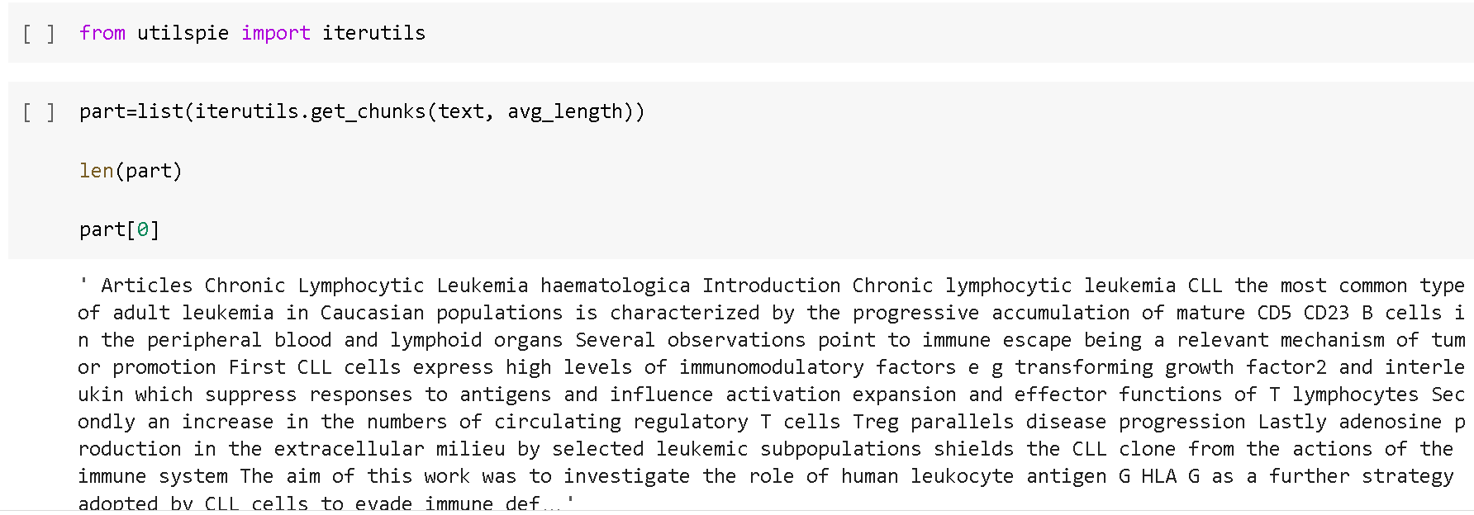
Data Preparation
Text Parsing
Usage of “utilspie” library(iterutlis package) for data parsing
“Utilspie” is a Python library that offers a sensible, human-friendly utilities which do not come along with Python installation
Text parsing is done because, we need to deal with a huge data. If not done, the current IDE will get affected with regular RAM-size available in the system. In order to avoid this issue we are parsing the data into chunks, so that it will work smoothly.

Slide 15
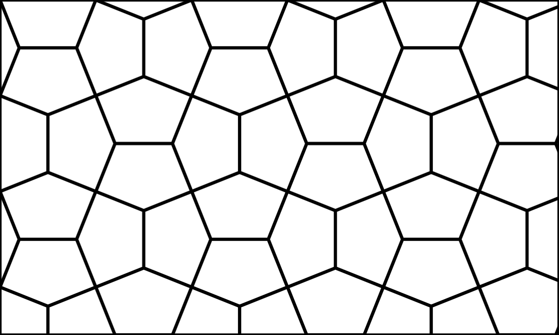
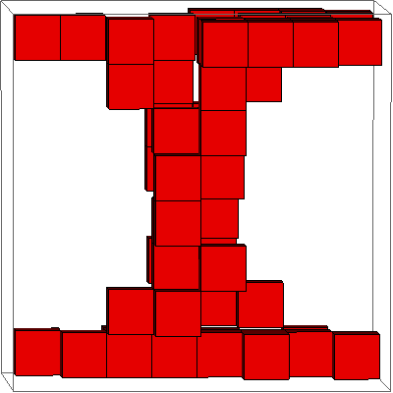
Model Building

Slide 16
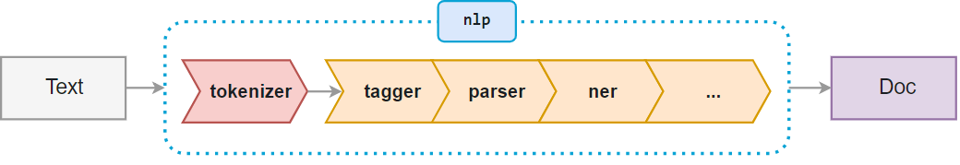
Introduction to NER
The Named Entity Recognition models built using deep learning techniques extract entities from text sentences by not only identifying the keywords but also by leveraging the context of the entity in the sentence.
One of the key challenges in training NLP-based models is the availability of reasonable-sized, high-quality annotated datasets. Further, in a typical industrial setting, the relative difficulty in garnering (gather or collect something, especially information or approval) significant time from domain experts and the lack of tools and techniques for effective annotation, along with the ability to review such annotations to minimize human errors, affects research and benchmarking of new learning techniques and algorithms.

Slide 17
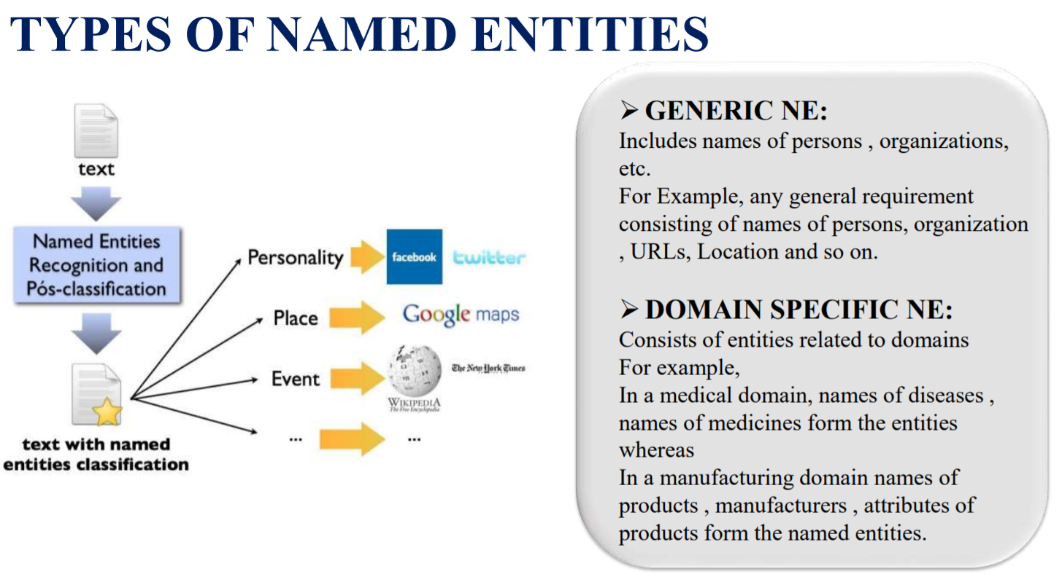

Slide 18
Model Building
Model Building using Pre-trained Models
Data Sources:
The Data used for testing and classifying was collected from the Client. However, we used four kinds of corpora to train and test the NER models, where each contained manual annotations for one or more entity types. The corpora were the National Centre for Biotechnology Information (NCBI) disease corpus for disease names, corpus for gene names and this was chosen to deactivate as the requirement was on other entities, and the BioCreative V Chemicals Disease Relationship (CDR) corpus for both disease and chemical names. The corpora consist of a training set, a development set, and a test set, which were respectively used to construct the models, determine the optimal parameters for models, and evaluate the models.

Slide 19
PRE-TRAINED MODELS:
Pre-trained models are created by researchers to solve a domain specific problem. Instead of building a model from scratch to solve a similar problem
The automatic extraction of meaningful relations from biomedical literature is crucial in various biomedical applications.
We propose a pre-trained model technique to improve these approaches without additional time-consuming.

Slide 20
Data Sources:
The Data used for testing and classifying was collected from the Client
Over View on Models, Packages, Corpora:
Models - Med7, Bio
Packages - spaCy, stanza
Entities of Interest - Proteins, disease names, chemicals
Corpora - JNLPBA, BC5CDR, BC4CHEMD

Slide 21

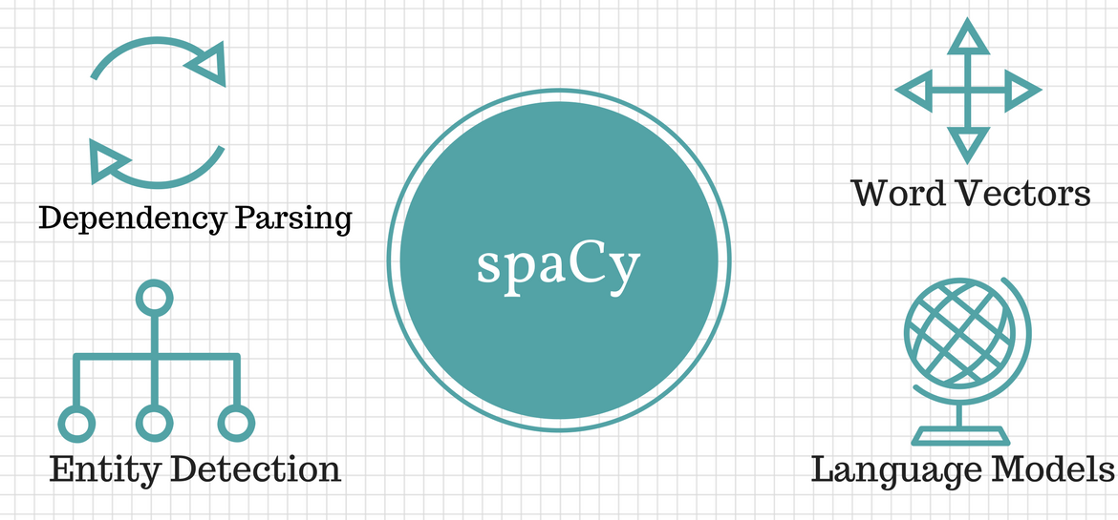
SPACY:
spacy is an open-source library for NLP in Python. It's written in Cython and is designed to build information extraction or natural language understanding systems. It's built for production use and provides a concise and user-friendly API
The spacy v3 trained pipelines are designed to be efficient and configurable. For example, multiple components can share a common “token-to-vector” model and it's easy to swap out
Spacy v3 features all new transformer-based pipelines that bring spacy’ s accuracy right up to the current state-of-the-art. You can use any pretrained transformer to train your own pipelines, and even share one transformer between multiple components with multi-task learning.

Slide 22
Med7:
Identification of concepts of interest in free texts is a sub-task of information extraction, more commonly known as Named-Entity Recognition (NER) and seeks to classify tokens (words) into pre-defined categories.
These models were trained to identify particular concepts in biomedical texts, such as drug names, organ tissue, organism, cell, amino acid, gene product, cellular component, DNA, cell types and others.
we focused on a particular subtask of clinical information extraction and developed a dedicated named-entity recognition model Med7 for identification of 7 medication-related concepts, dosage, drug names, duration, form, frequency, route of administration and strength.
Med7 is a freely available python package for spaCy.

Slide 23
Trail On Med7 Pre-trained model
Named-Entity Recognition (NER) and seeks to classify tokens (words) into pre-defined categories. The models were trained to identify drug names, organ tissue, organism, cell, amino acid, gene product, cellular component, DNA, cell types and others.
we focused on a particular subtask of clinical information extraction and developed a dedicated named-entity recognition model Med7 for identification of 7 medication-related concepts, dosage, drug names, duration, form, frequency, route of administration and strength.
Med7 is a freely available python package for spaCy.

Slide 24
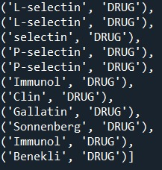
FAILED ATTEMPT:
We are using Med7 Version 2.3.5
After pre-processing of data text is given to Med7
Entities like proteins are labelled as drugs
To overcome that we worked on en_ner_jnlpba_md shared task of bio-entity recognition along with GENIA using on of the latest Version of spaCy.
pip install https://med7.s3.eu-west-2.amazonaws.com/en_core_med7_lg.tar.gz
https://s3-us-west-2.amazonaws.com/ai2-s2-scispacy/releases/v0.4.0/en_ner_jnlpba_md-0.4.0.tar.gz

Slide 25
FAILED ATTEMPT:
Med7 and spaCy-JNLPBA uses different versions and can’t run in single environment.
So, we faced compatibility issues.
Even the f1 scores are not good to compare with stanza . So we moved to stanza.

Slide 26
F1 Scores:

Slide 27
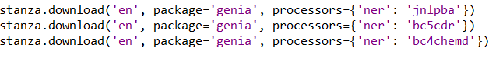
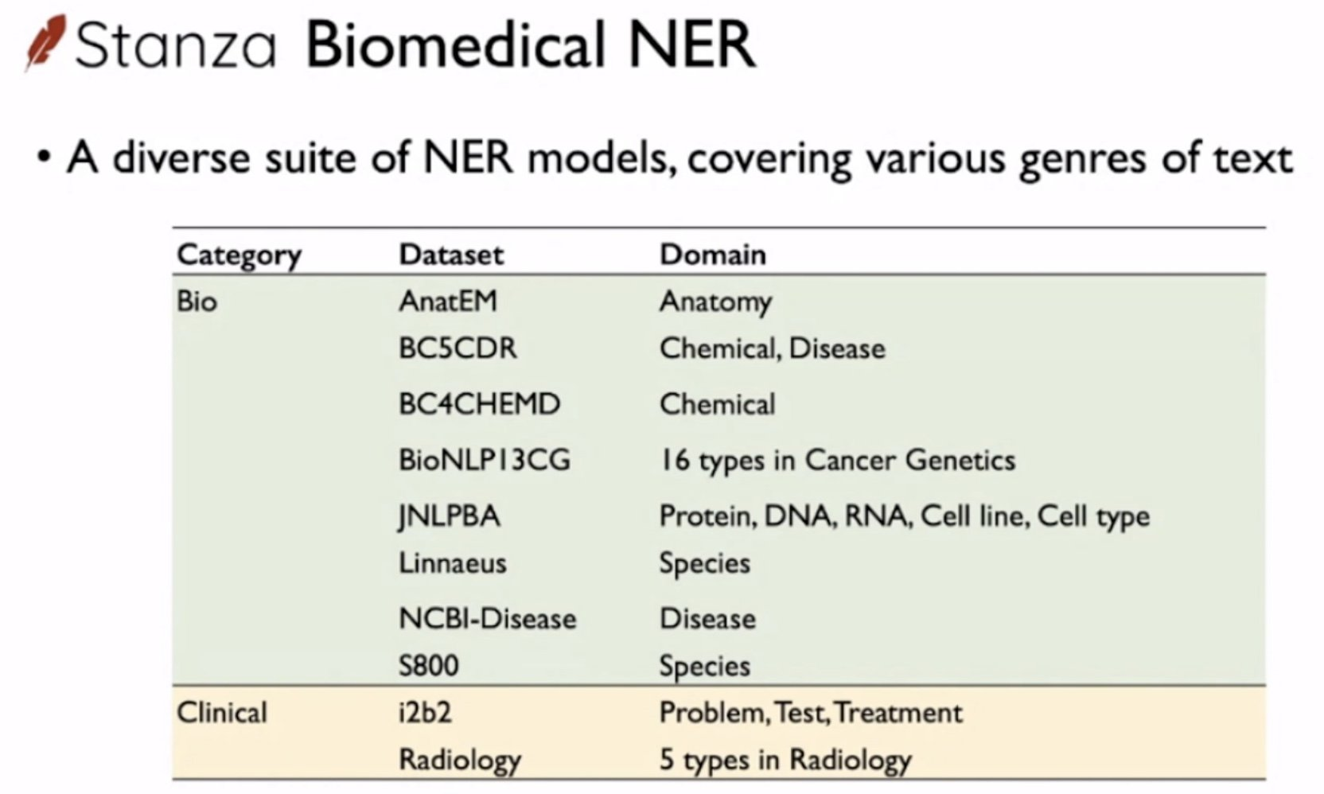
The STANZA Package:
Stanza is built with highly accurate neural network components for efficient training and evaluation of annotated data.
It supports the usage of different pipelines and transforms the given text to have a parse dependent syntactic structure and also to recognize the named entities in the given data.
Stanza Download:

Slide 28
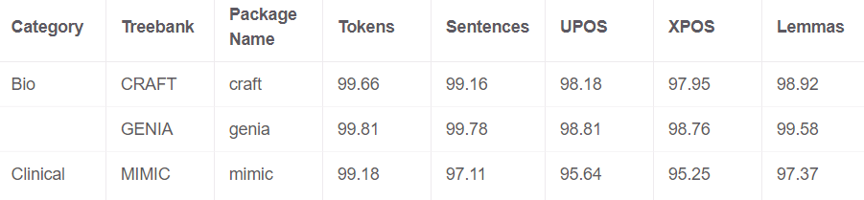
Stanza-Genia Treebank: In comparision with the craft, Genia treebank has better results.

Slide 29
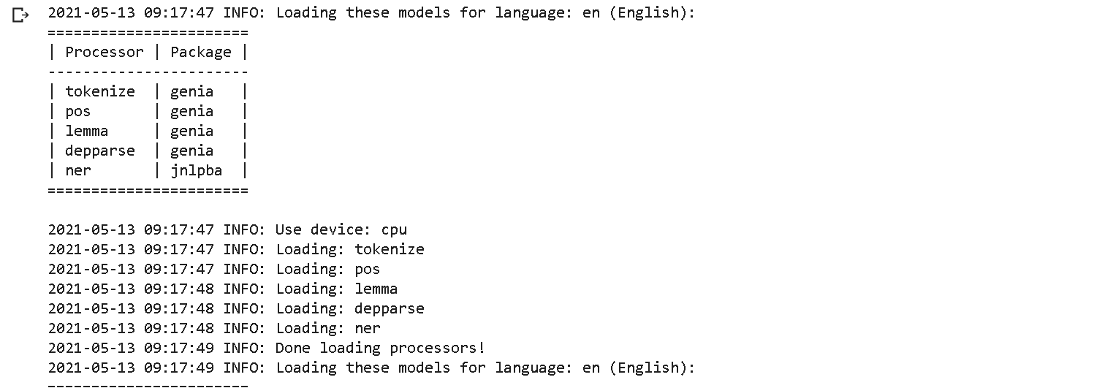
PIPELINES USED IN STANZA:
JNLPBA recognizes entities like Cell Type DNA, RNA, Protein, Cell-line…etc.
BC5CDR (BioCreative V Chemical Disease Relation) Corpus recognizes Chemicals and Diseases
BC4CHEMD (BioCreative IV Chemical and Drug) Corpus recognizes only for chemicals

Slide 30
The Corpora:
NCBI- We used the NCBI corpus for the disease NER task. The NCBI disease corpus is the gold standard of disease name recognition. It is a manually annotated resource for biomedical text created and curated by a team of 14 annotators. It consists of 793 PubMed abstracts and 6892 disease mentions, with 790 unique disease concepts mapped to MeSH and OMIM identifiers.
BC5CDR- We used the CDR corpus for the disease and chemical NER task. The BioCreative V challenge was organized for CDR tasks based on disease named entity recognition (DNER) and chemically induced disease (CID) relation extraction tasks. It is composed of 1500 articles with 4409 annotated chemical names, 5818 disease names, and 3116 CID relations. This corpus has become a valuable resource for research on text mining.
BC4CHEMD- The annotation is Chemical. It’s provided by the Bio-Creative IV Shared Task for chemical mention recognition .. CHEMDNER collects 10,000 PubMed abstracts that contain a total of 84,355 chemical entity mentions labeled manually by expert chemistry literature curators, following annotation guidelines specifically defined for this task.
JNLPBA- corpus consists five categories of entities (protein, DNA, RNA, cell line, and cell type) were manually annotated.. Sentences are pre-tokenized in the JNLPBA The current BNER(biomedical named entity recognition) corpora, which play important roles in these tasks, paid less attention to achieve the criteria for BRE(biomedical relation extraction) task. In this study, we present JNLPBA corpus

Slide 31
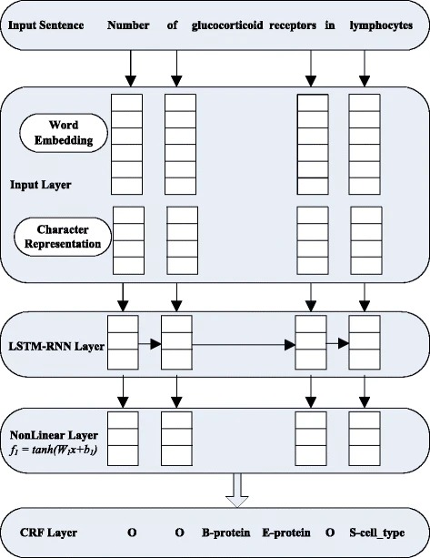
Neural Architecture of a Basic Pre-trained Model focusing on Protein entity extraction:

Slide 32
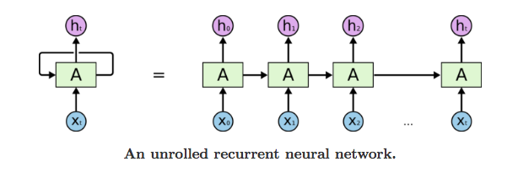
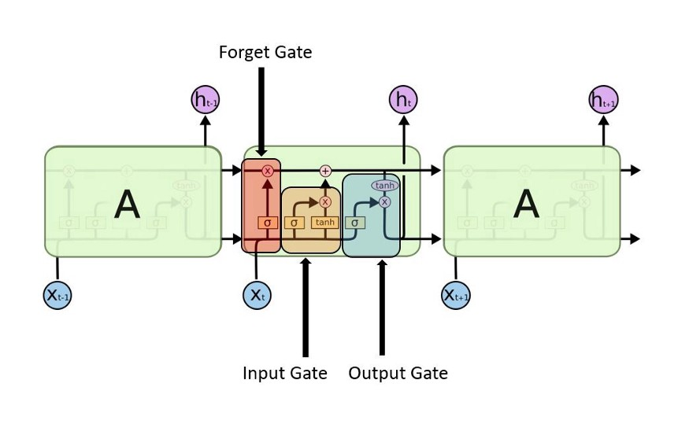
Neural Architecture of a Basic Pre-trained Model focusing on Protein entity extraction:
Deep Learning Techniques:
RNN (Recurrent Neural Network)
Recurrent Neural Network is a generalization of feedforward neural network that has an internal memory. RNN is recurrent in nature as it performs the same function for every input of data while the output of the current input depends on the past one computation. After producing the output, it is copied and sent back into the recurrent network. For making a decision, it considers the current input and the output that it has learned from the previous input.
LSTM RNN
Long Short-Term Memory (LSTM) networks are a modified version of recurrent neural networks, which makes it easier to remember past data in memory. The vanishing gradient problem of RNN is resolved here. LSTM is well-suited to classify, process and predict. It trains the model by using back-propagation.

Slide 33
Word embedding's are distributed representations and capture distributional syntactic and semantic information of the word. Several types of word embedding's trained from different external sources are used in our LSTM-RNN models.
Vector Representation

Slide 34
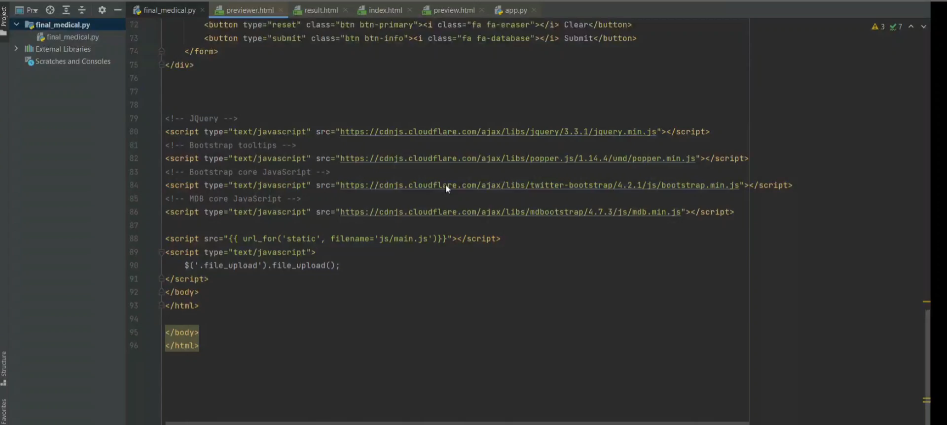
The Final Codes:

Slide 35
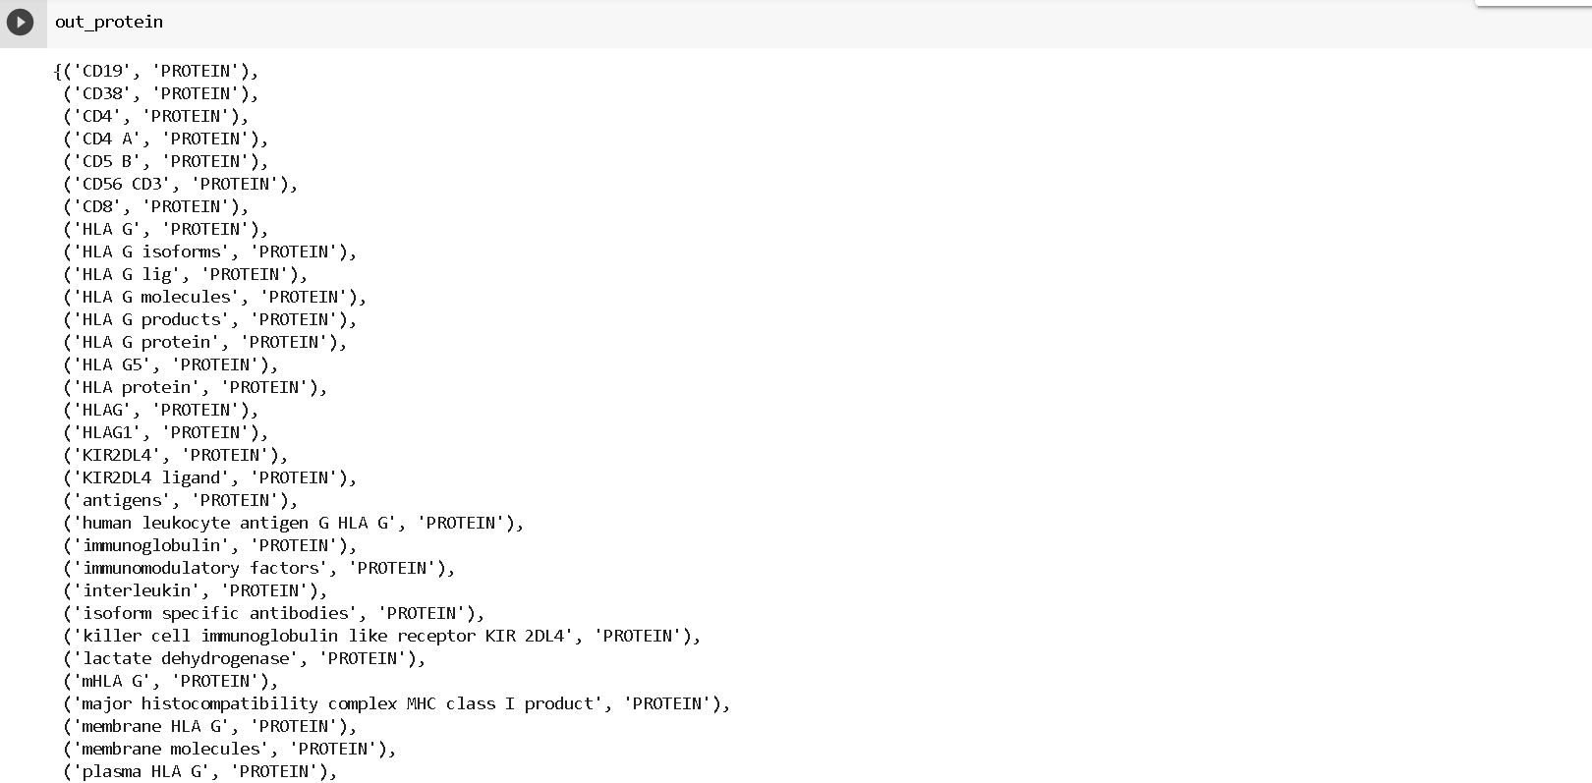
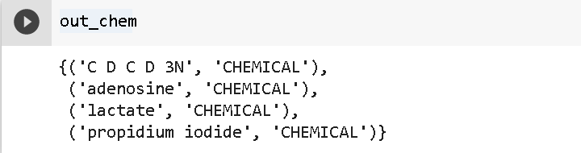
Output after applying our pre-trained models:

Slide 36
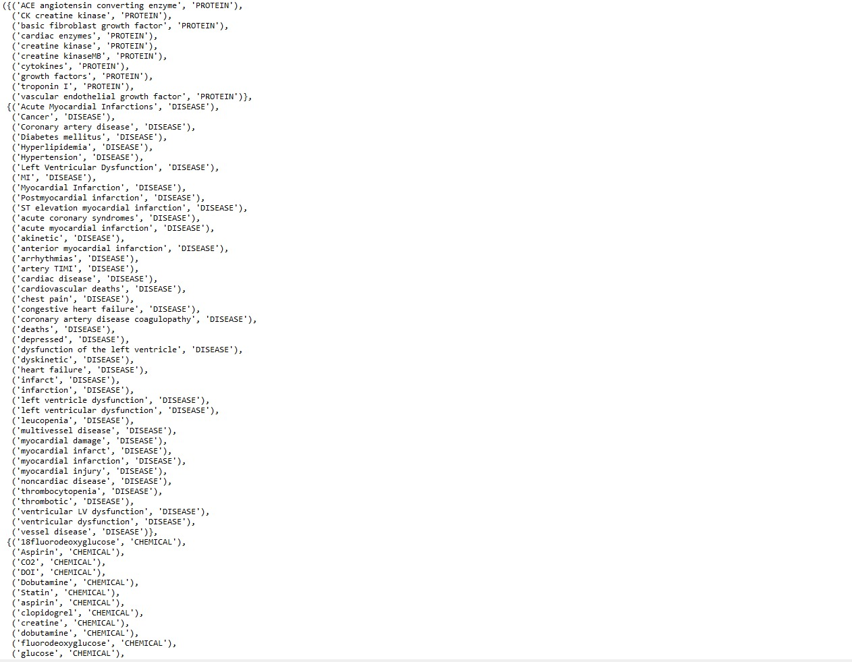
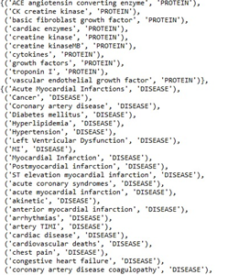
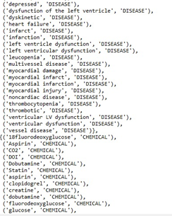
Output after applying our pre-trained models:

Slide 37
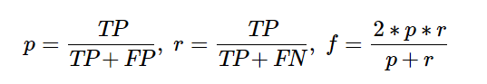
3. Evaluation On Pretrained Models
Using the development sets, for the word-level CLSTM model, we decided on three corpora NCBI, GM, and CDR corpora, respectively.
Using the test sets, we compared all methods in terms of precision, recall, and F-score
The Pre-trained models counted the true positives (TP), false positives (FP), and false negatives (FN). The evaluation was based on measures of precision (p), recall (r), their harmonic average, and the F-score (f), as follows:

Slide 38
Deployment Strategy
Web Based: Usage of Python Flask
Flask is a micro-framework for Python
• Easy to code
• Easy to configure
• RESTful
• Testable
The web application is browsed at 127.0.0.1:5000

Slide 39
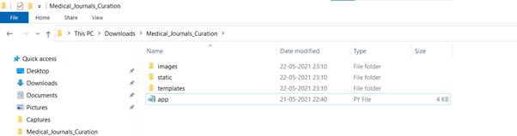
Deployment
At Persistent, we built a custom web browser-based tool which helps minimize time commitments from domain experts and the manual effort required to generate such a training dataset. The following figure displays a screenshot of the annotation tool. Text mining in the biomedical domain is receiving increasing attention. A key component of this process is named entity recognition (NER). iste

Slide 40
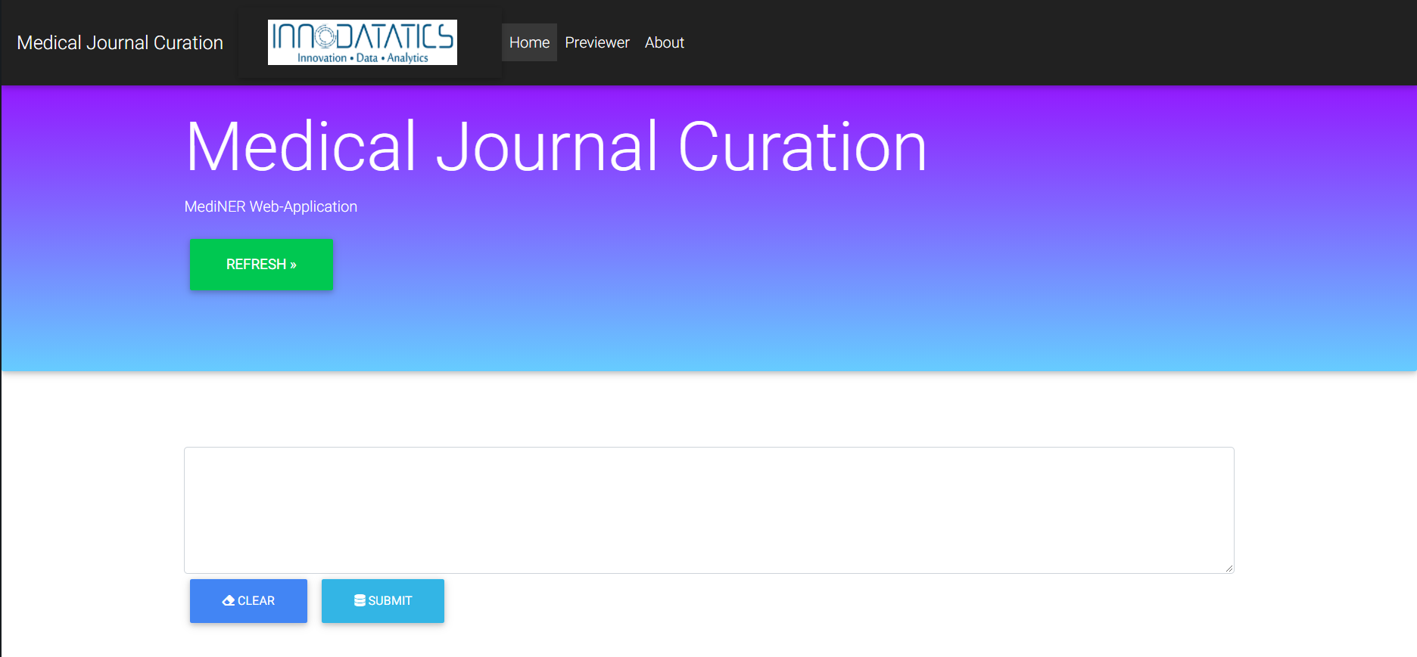
Deployment
The Final web Application looks like:
--→ Home Page

Slide 41
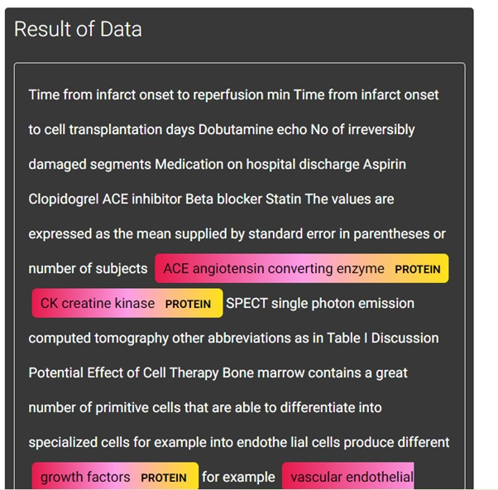
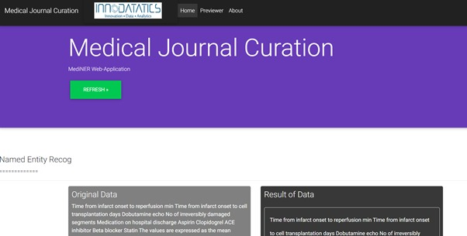
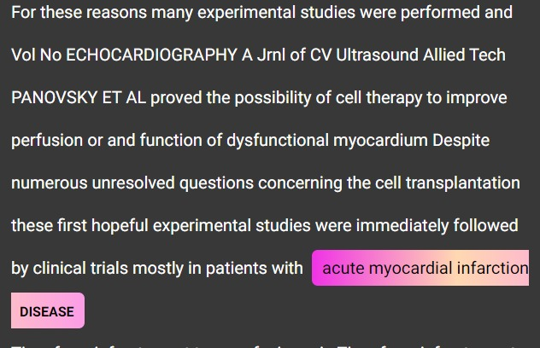
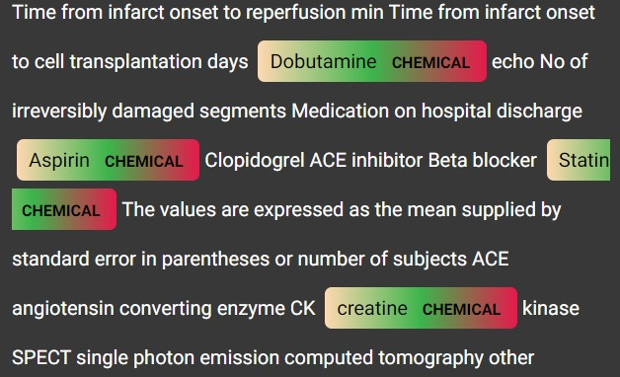
Deployment
The Final web Application looks like:

Slide 42


